Slide 1
Introduction to Machine Learning
CAREER PATHS
Andreu Arderiu
NORTHIN SUMMER SCHOOL
Barcelona, July 2023

Slide 2
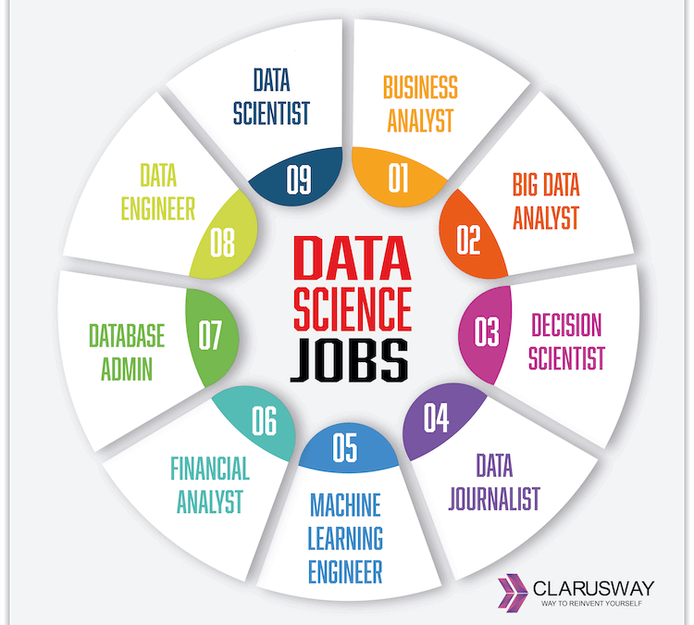
Jobs in Data Science
Healthcare
Retail
Finance
Marketing
Manufacturing
...

Slide 3
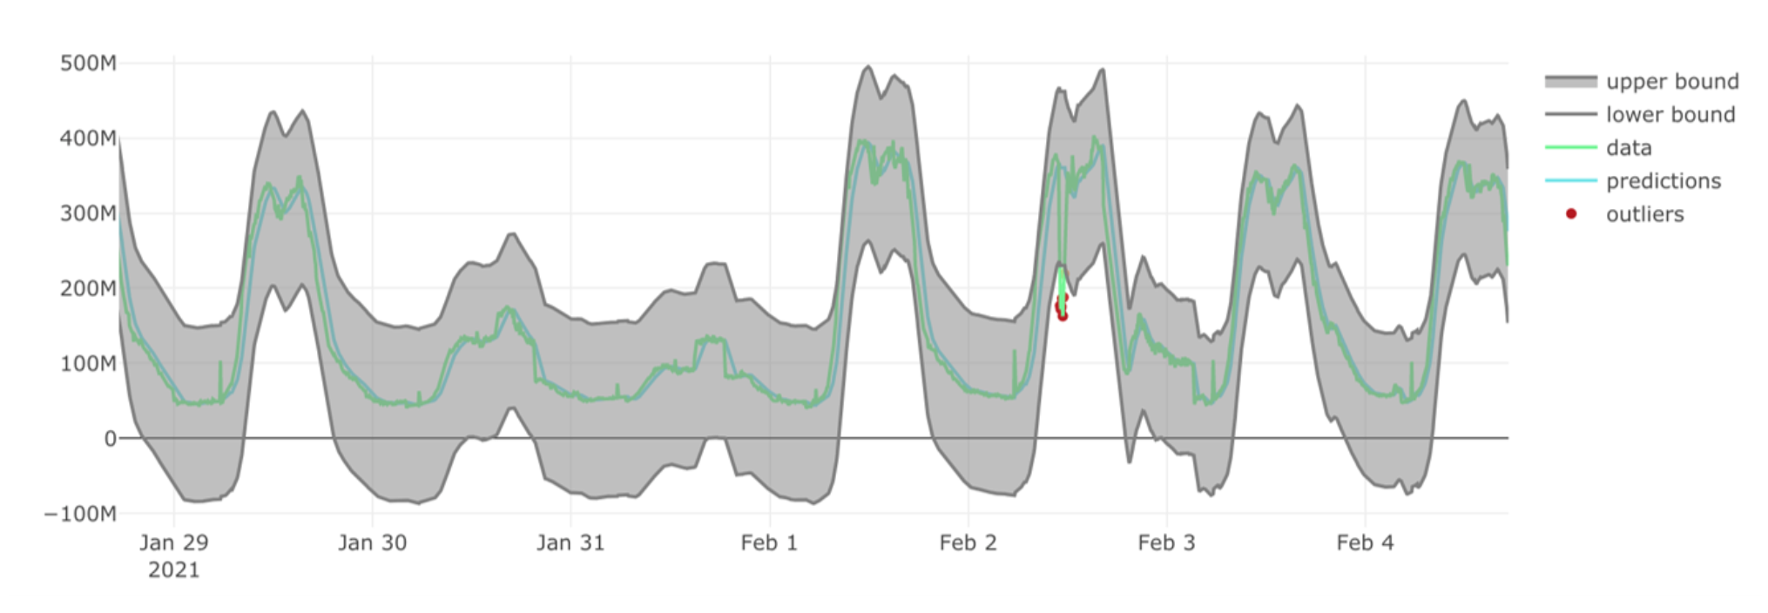
My personal experience (I)
Telecom company
Monitor traffic anomalies -> ML for anomaly detection
Outages
Cyberattacks
Emergencies
...

Slide 4
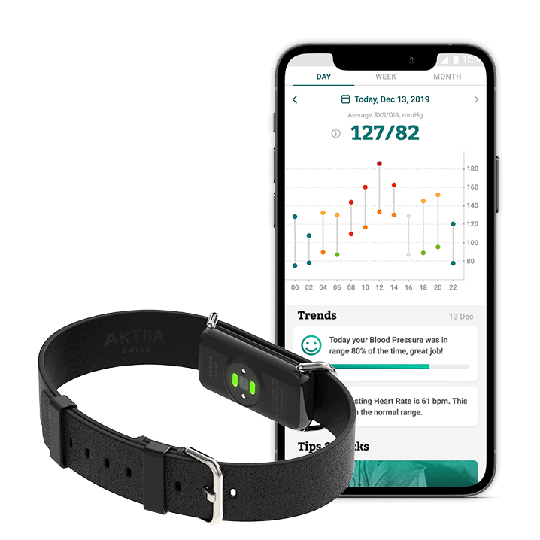
My personal experience (II)
MedTech startup (healthcare domain)
Wearable bracelet monitoring blood pressure (BP)
Use ML to Predict BP with the light signal

Slide 5

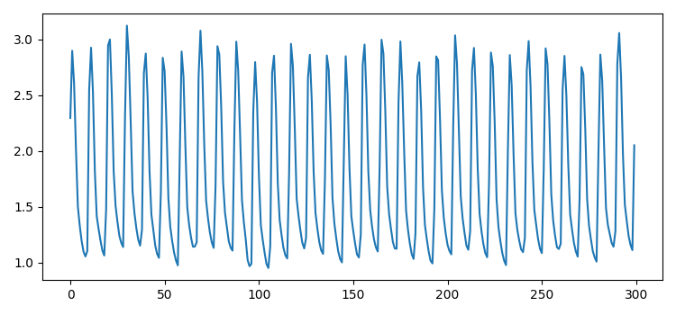
Time for a test: Real job interview test
The goal is to classify signals (time series) into different "fruits"
Use everything you learned so far to approach the challenge!

